Slide 1


Developers : Oscar Aquino – Elizabeth Garcia – Ryan Bates – Jesse Kelly
A website dedicated to the establishment of quality choices in what to watch established by the consumers, and how to find them.

Slide 2
Why What2Watch?
What’s important to us?
The Individual User
The Connection Individual Users have with other members
Relatability when it comes to style and usability
Organization in reference to both site layout and backend programming
Here, we want to create a comfortable environment that will equip the user with the right set of tools when deciding what to watch. At the forefront of our first release, we’re hopeful to build a community of people that both have a passion for watching great films and can enjoy their platform experience. To summarize, the implementation of functionality such as the search functionality, a user sign-up, and a discussion section has been prioritized.

Slide 3
Priority 1 Functions
It’s important for any project to have a foundation, and we feel that the following three functions provide a cohesive enough platform for a good user experience.
Register
Each user that registers is uniquely identified by his/her username and password. Set up includes a sign-up page with entries prompting the user for name, e-mail, and the creation of a password.
Search
With the implementation of code that uses an HTML form structure, a java-script file is loaded based on when the user presses search. This section of code saves the string into local storage, and then sends it to a function that concatenates the string into a JSON object in order to be referenced in the API database.
Post Feedback
On each title page, below it exists a comments section where users can upvote/downvote and reply to other users. Entries are shown as examples under home page movie titles.

Slide 4

System Architecture - Database
Development Languages
HTML
CSS/BOOTSTRAP
Interfacing Languages
JavaScript
Php
Firebase
With this architecture, we will be adhering to the compatibility of devices that have browsing functionality and can run browser platforms such as Google Chrome, or Microsoft Edge.
The site’s external database information will be harvested from an API which is implemented in the code, and the user authentication information is kept track of with the implementation of firebase.

Slide 5
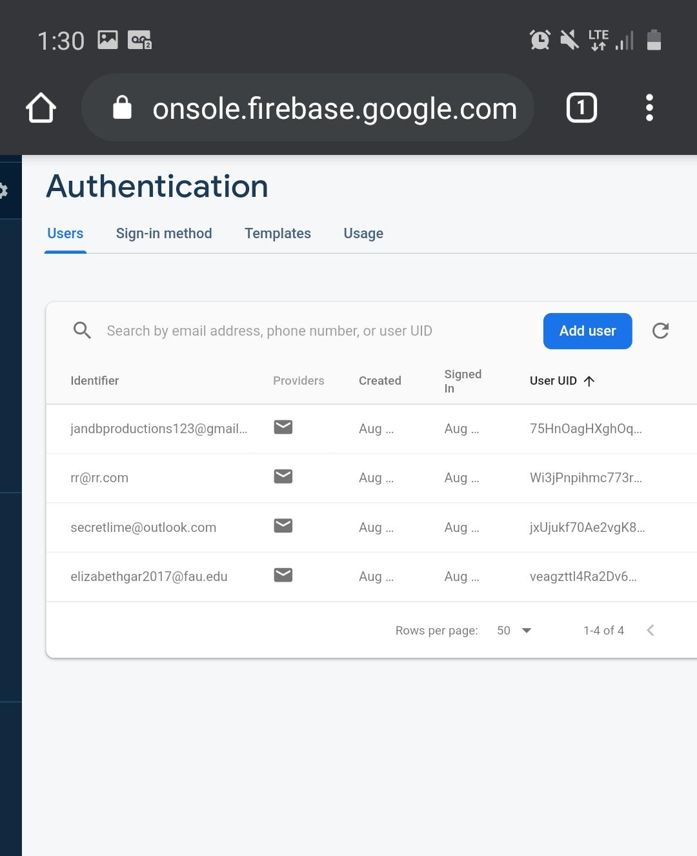
API Functions & Firebase Example
const search_movie = function(){
document.getElementById('search_button').addEventListener('click', sendMovie);
}
const sendMovie = function(event){
event.preventDefault();
const user_title = document.getElementById('title').value;
localStorage.setItem('title', JSON.stringify(user_title));
document.getElementById('form-search').submit();
}
function consoleTitle(){
console.log('Hello, Console!')
}
Activated Users:

Slide 6
API Call Function
async function apiCall(){
let movie_name_storage = localStorage.getItem('title');
const response = await fetch('https://www.omdbapi.com/?t=' + movie_name_storage + encodeURI('&apikey=7b3941a8')+ "&plot=full");
const api_response_print = await response.json();
document.querySelector('#details_title').innerHTML = api_response_print.Title;
document.querySelector('#director_name').innerHTML = api_response_print.Director;
document.querySelector('#cast_names').innerHTML = api_response_print.Actors;
document.querySelector('#genre_details').innerHTML = api_response_print.Genre;
document.querySelector('#release_year').innerHTML = api_response_print.Year;
document.querySelector('#runtime_details').innerHTML = api_response_print.Runtime;
document.querySelector('#country_details').innerHTML = api_response_print.Country;
document.querySelector('#plot_details').innerHTML = api_response_print.Plot;
document.querySelector('#poster_details').src = api_response_print.Poster;
console.log(api_response_print);
}
document.addEventListener('DOMContentLoaded', search_movie);
function modify_details_page(){
console.log("loading modify details script");
apiCall();
}

Slide 7
Scenarios, Use Cases
The thinking behind creating a usable website must adhere to the hypothetical scenarios that the user will face while spending time on the site.
Initial Assumption - The user is browsing, and they have something they want to watch or a film in mind they’re interested in getting to know more about.
Normal Events:
The user wants to sign up for the site
The user wants to view their saved list
The user wants to search for a movie
Concurrent Events:
The user wants to purchase a movie through the link to external vendor
The user wants to participate in the comment section for feedback
The user wants to leave feedback in the form of a rating

Slide 8
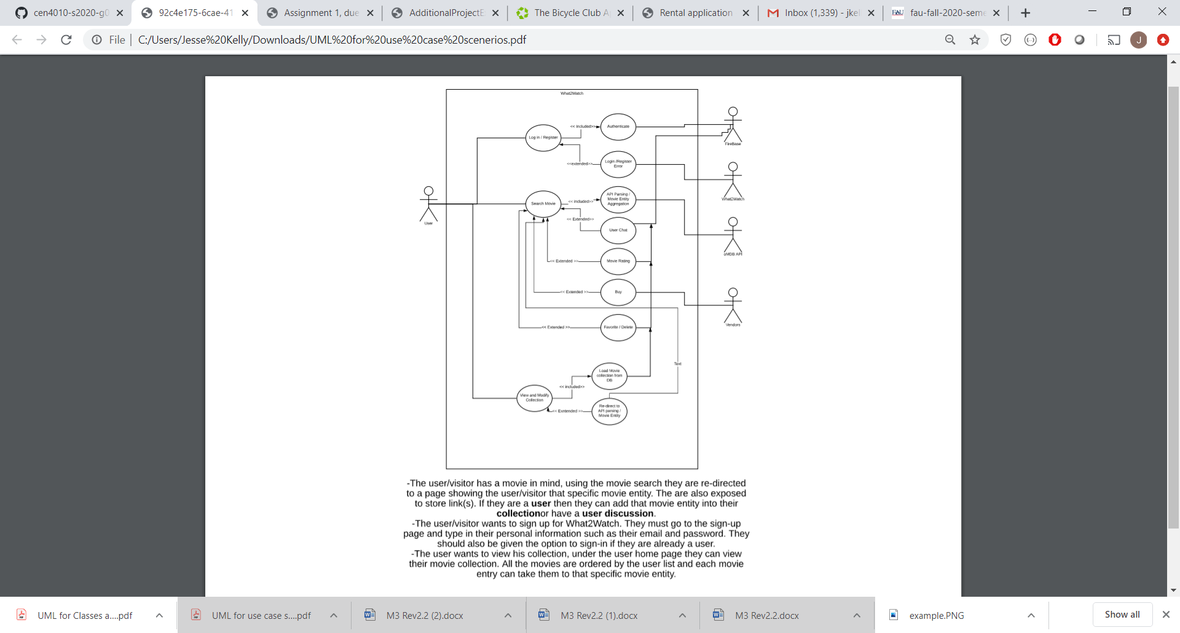
UML Diagram – Use Cases, Scenarios

Slide 9
Definition of Non-Functional Requirements
In order to build a comprehensive platform, it’s important to consider the boundaries at which performance may be impacted. This leads to the definition of some constraints which were put in place as a result of the non-functional requirements that we want to focus on.
For requirements such as performance, compatibility, reliability, security, and usability, in the following slide are some examples of system constraints that will help preserve the performance of our platform.

Slide 10
System Constraints
Response time – The software will only retrieve outside data from one API containing all the necessary information as an outside source. Flags can be used for delays after 0.5 seconds, 5 seconds, and 10 seconds where if it reaches an unresponsiveness that lasts for 10 seconds the software should provide some solution based on the exception thrown.
Scalability – We will define the capacity of the software in terms of users to be 3,000 users for the first version that we put out in order to protect the responsiveness of the site.
Hardware – Low level hardware specifications will be required in order to welcome as many devices as possible
Software – Software will support new operating systems without the consideration of outdated versions.
Reliability – Based on the capacity limit of the users, if the software reaches a 10 second delay, this information can be stored in a count. If the count reaches more than 3 crucial delays, we will temporarily have the site under construction for 24 hours to fix the issue.
Security – Only a select few members (developers) will have a management status for on site issues. Software should be compliant with regulation user security. Heavy focus on protecting user information as no payment information will be required.
Usability – How easy is it to sign up? How easy is the search function? How does the site appeal to the user from both a visual and technical perspective? User must feel satisfied and they must be able to reach their goals efficiently.

Slide 11
Team Members Contribution – Thank You!
Link to the current version of our site:
https://lamp.cse.fau.edu/~cen4010s2020_g02/Milestone_4/BOOTSTRAP/www/index.html
CEN 4010 Principles of Software Engineering - Summer 2020
Group 2 “The Fam” Evaluation:
Oscar Aquino (25%), Back End Team Leader, Software Developer
Ryan Bates (25%) , Front End Team Leader/Scrum Master, Software Developer
Elizabeth Garcia (25%), Github/Trello Master, Software Developer
Jesse Kelly (25%), Software Developer

